Slide 1
Mainstay Life Services
Emily Zhu, Helen Peng, Alva He, Sophia Mou, Derek Gao, Edward Brownhill

Slide 2
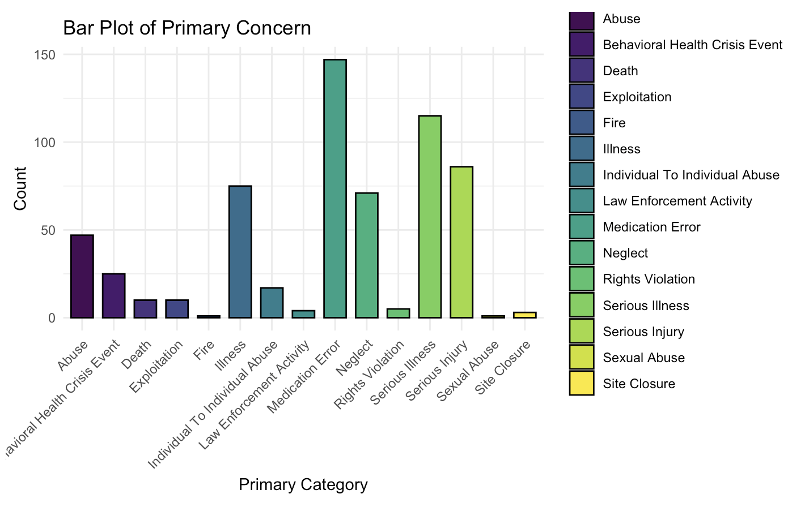
Frequency by Type
We found that some of the most common conditions over the past three years are:
Medication error
Serious illness
Serious injury
Neglect
We’ve made a deeper analysis into all four.
Notes:
We’re looking at records over the past 3 years, 2022 - 2024

Slide 3
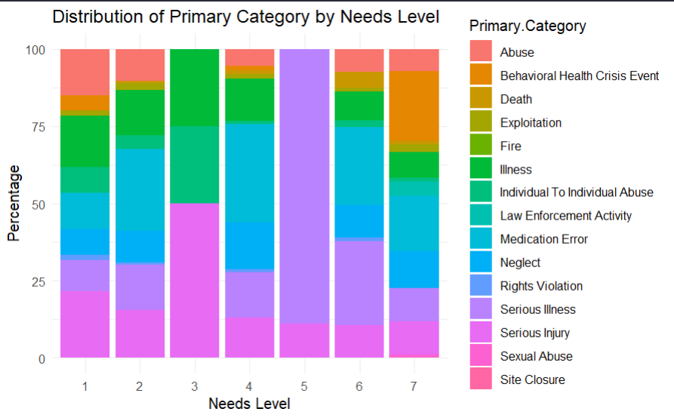
A Look at Needs Level
Primary categories are graphed with the percentage within each needs level, allowing for a comparative view of category prevalence.
Higher needs are dominated with serious illness and serious injury, lower levels are more diverse.
Notes:
Edward: A chi-square test was conducted and we found that needs level and we found difference

Slide 4
Medication Errors

Slide 5
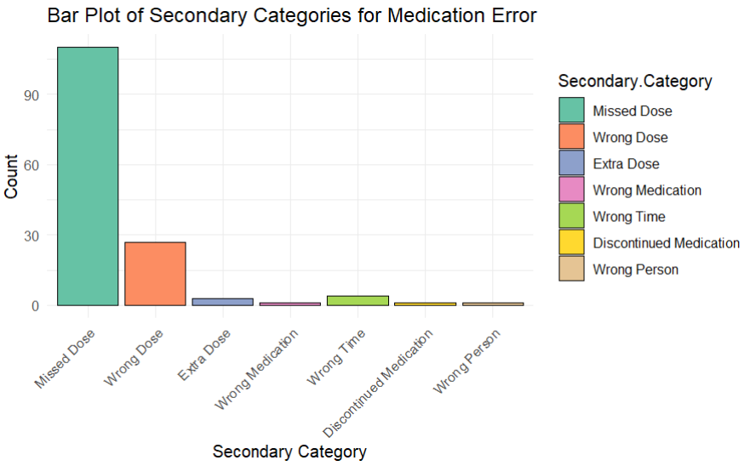
Medication Errors Frequency by Type
We found that the most common error types are Missed Dose (at 110 counts) and Wrong Dose (at 27 counts).
We’ve made a deeper analysis into just these two types of errors.

Slide 6
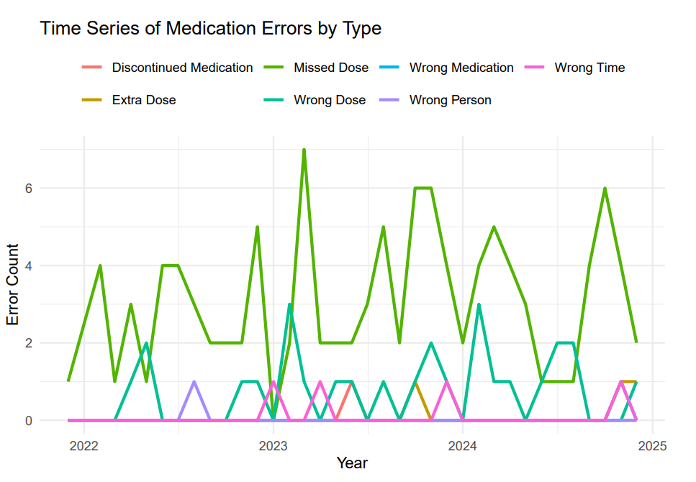
Medication Errors Over Time

Slide 7
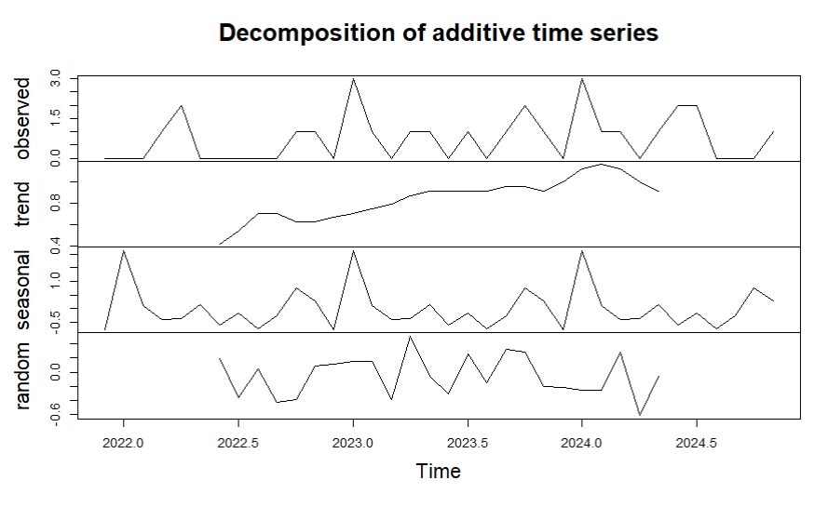
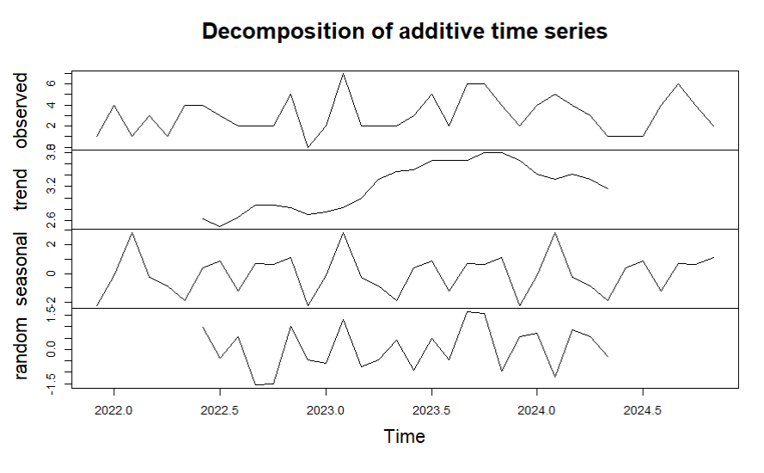
Medication Errors Over Time
Wrong Dose
Missed Dose
Notes:
The data indicates that both wrong doses and missed doses have generally increased over time, though there has been a recent decline, possibly due to potential improvements or changes implemented by Mainstay. A seasonal trend is also evident, with errors peaking in the winter, likely due to increased illness or added strain on the healthcare system.

Slide 8
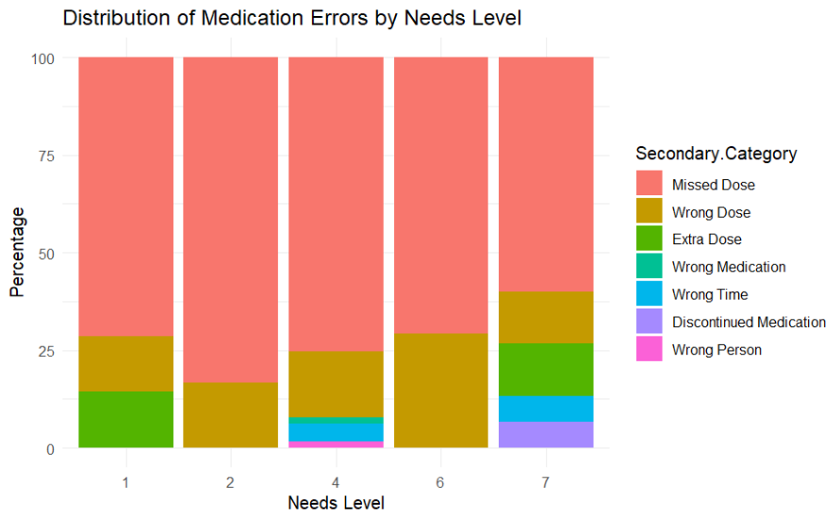
Medication Errors By Needs Level
We found no connection between the level of care needed and the type of medication error.
This is a positive outcome as errors are not disproportionately occurring in more critical situations, which would be a larger concern.

Slide 9
Illnesses
(Serious Illness + Illness)

Slide 10
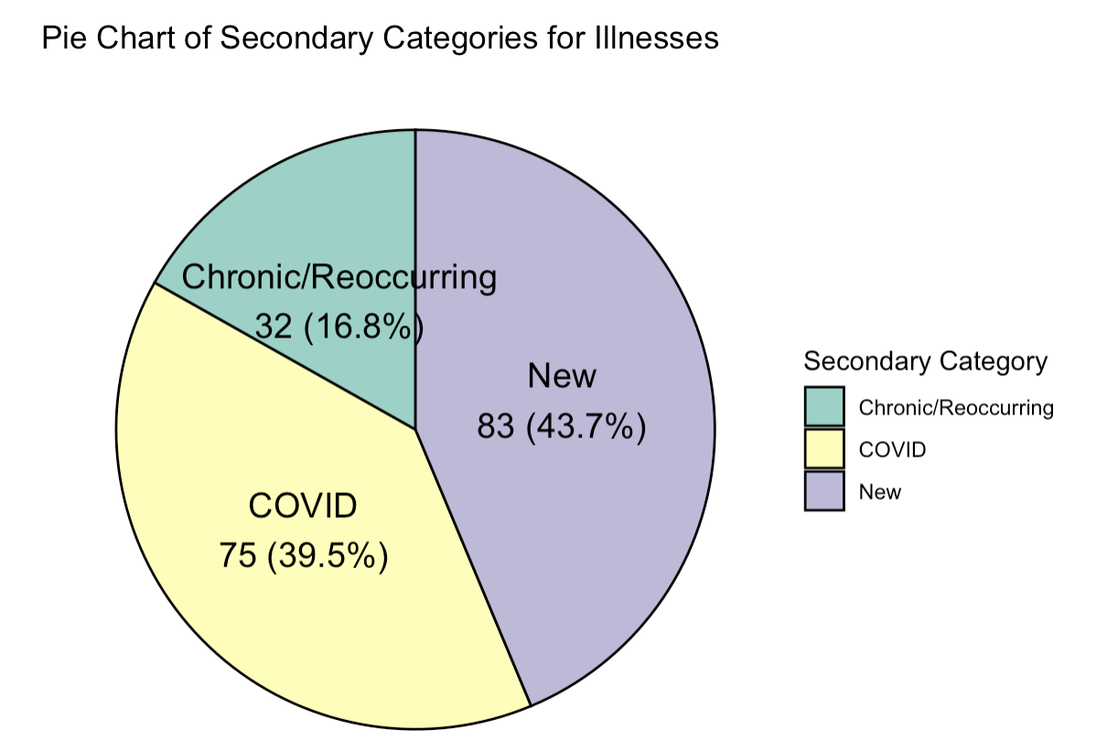
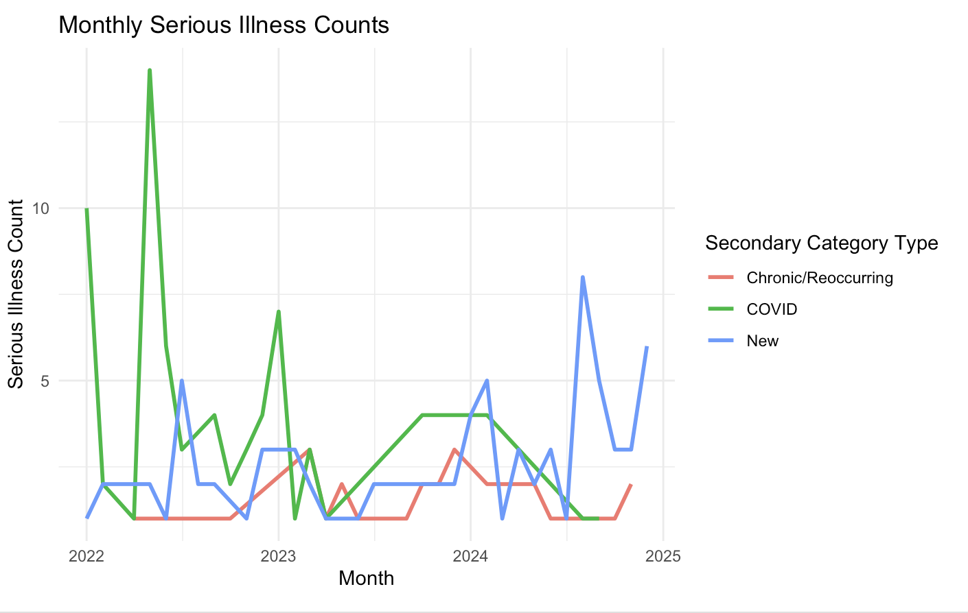
Illness by Type
We found that most cases of illnesses are COVID or new ones, but there is a trend of decreasing COVID cases across the years.
Chronic cases have stayed about the same.
New cases have fluctuated but shown increase.
Possible conclusions: shift resources more to new illnesses

Slide 11
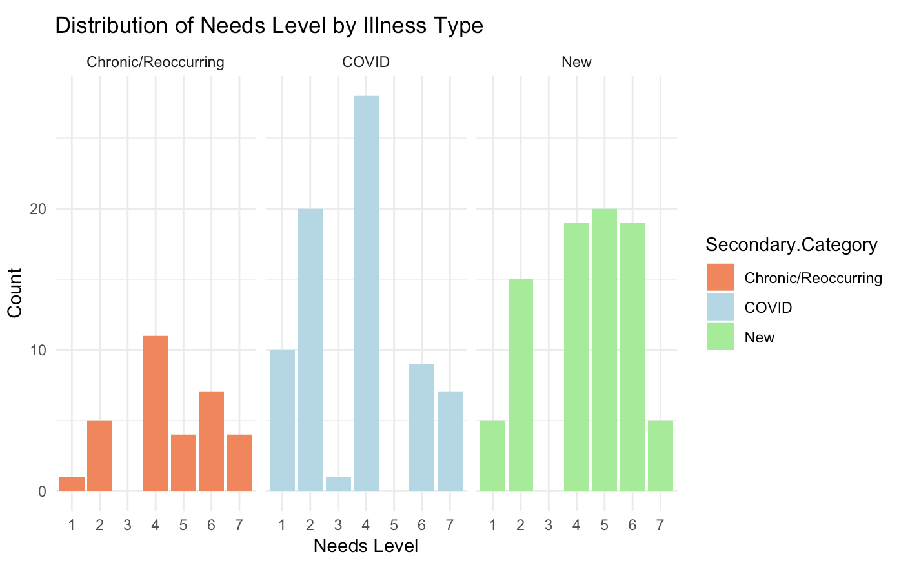
Illness Frequency by Type and Needs Level
By chi-squared test, we find that the relationship between illness type and needs level is significant.
Applying a linear model reveals that whether or not the illness was COVID is significant in predicting needs level.
Notice that serious illnesses tend to have needs levels around 4 - 6 whereas for COVID the needs levels are around 2 - 4.

Slide 12
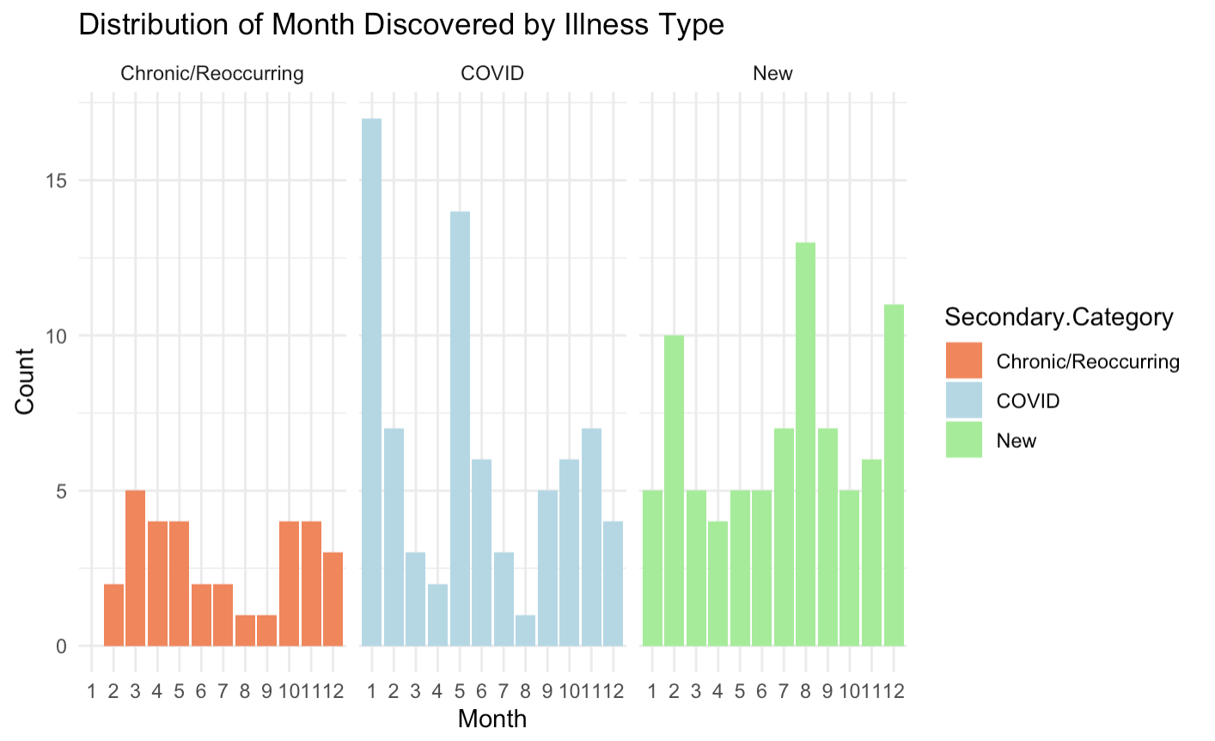
Illness Frequency by Type and Month Discovered
By chi-squared test, we find that the relationship between illness type and month discovered is significant.
Whether the patient had COVID, # of days between occurrence and discovery, and month discovered have significant relationships via linear model.
Notes:
Even if COVID isn’t as much of a concern anymore, this is still something we can use: for example, if we discover some illness but don’t know when it occurred, we can use the month we discovered it in and use that to predict when it occurred.

Slide 13
Serious Injury

Slide 14
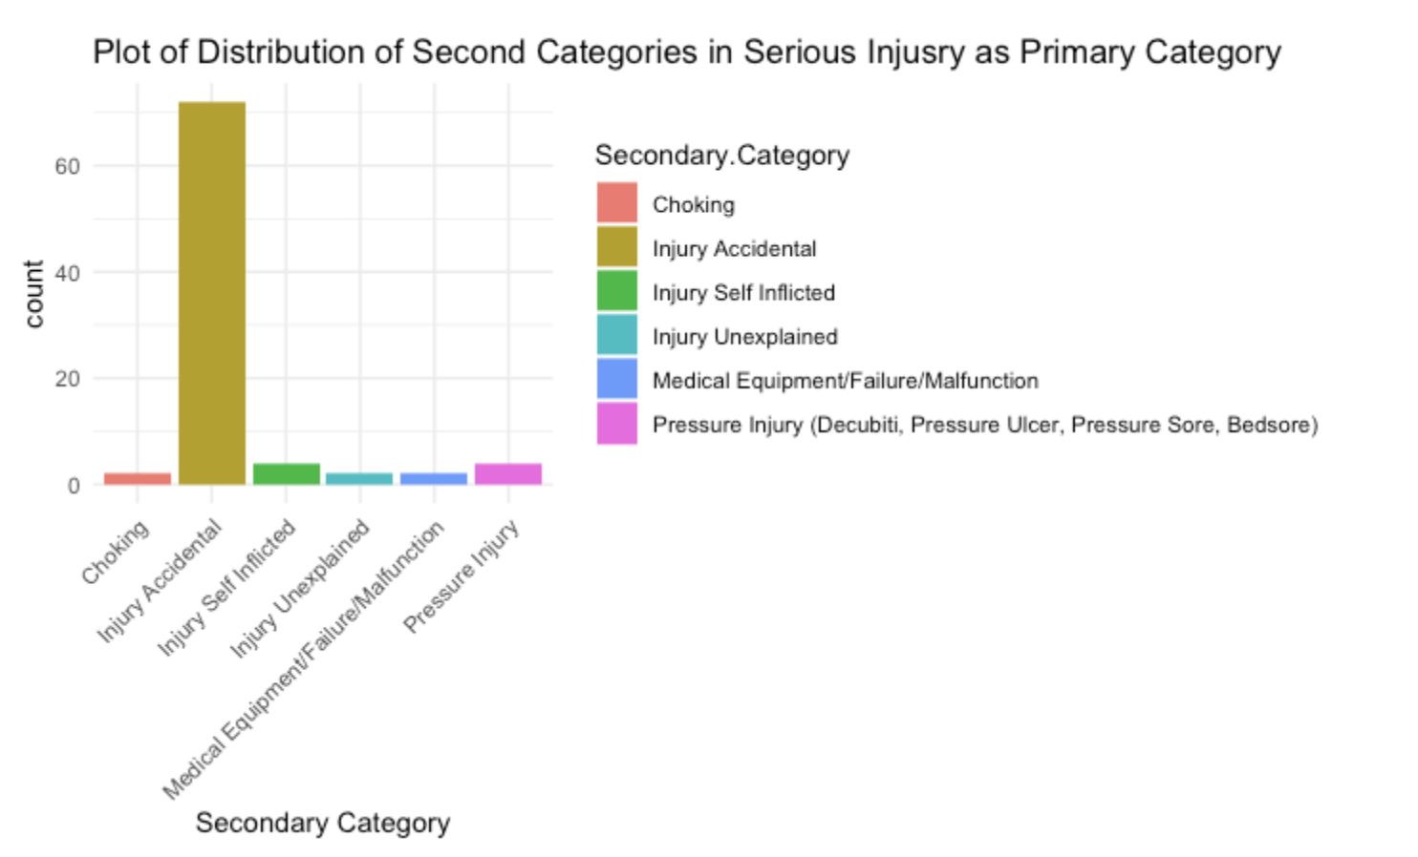
Serious Injury Frequency by Type
We found that the common secondary category within Serious Injury is Injury Accidental, followed by Pressure Injury. The rest categories have equal frequencies of occurring. There were no patterns of any of these injuries occurring at any specific time of a season.

Slide 15
Neglect

Slide 16
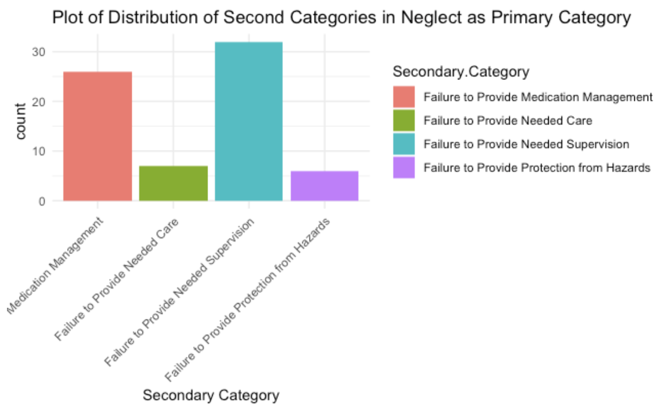
Neglect Frequency by Type
We found that the common secondary category within Neglect is Failure to Provide Needed Supervision, followed by Failure to Provide Medication Management, leading to possibly more personal management needed.

Slide 17
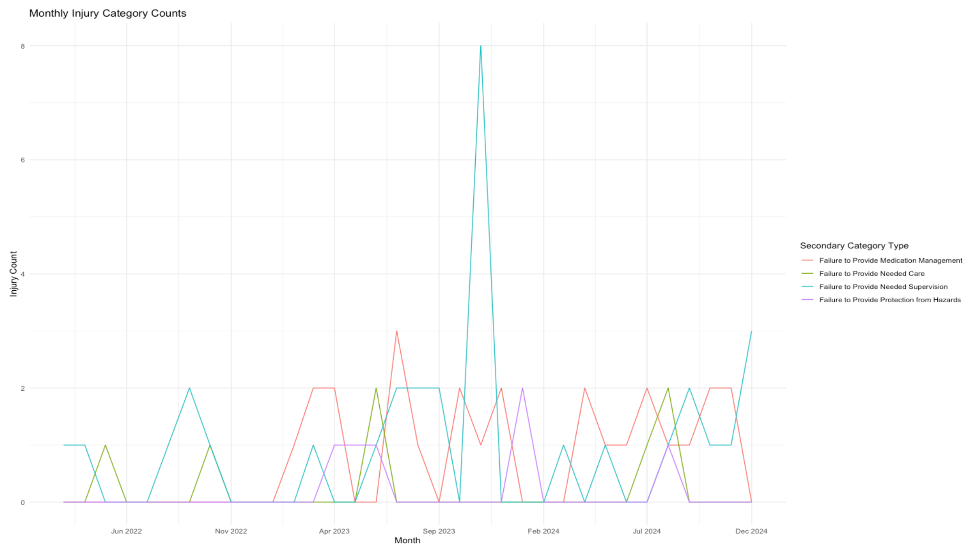
Neglect Frequency by Needs Level
This plot shows the occurrence of Neglect across time between 2022 and 2024. There are more cases of failure to provide needed supervision at the end of 2023 and 2024, which makes sense because most people are on holidays, so more attention during that time would definitely help reduce the cases.
There are no obvious trend of a certain type of Neglect occurring in a specific season.
Notes:
Correct plot

Slide 18
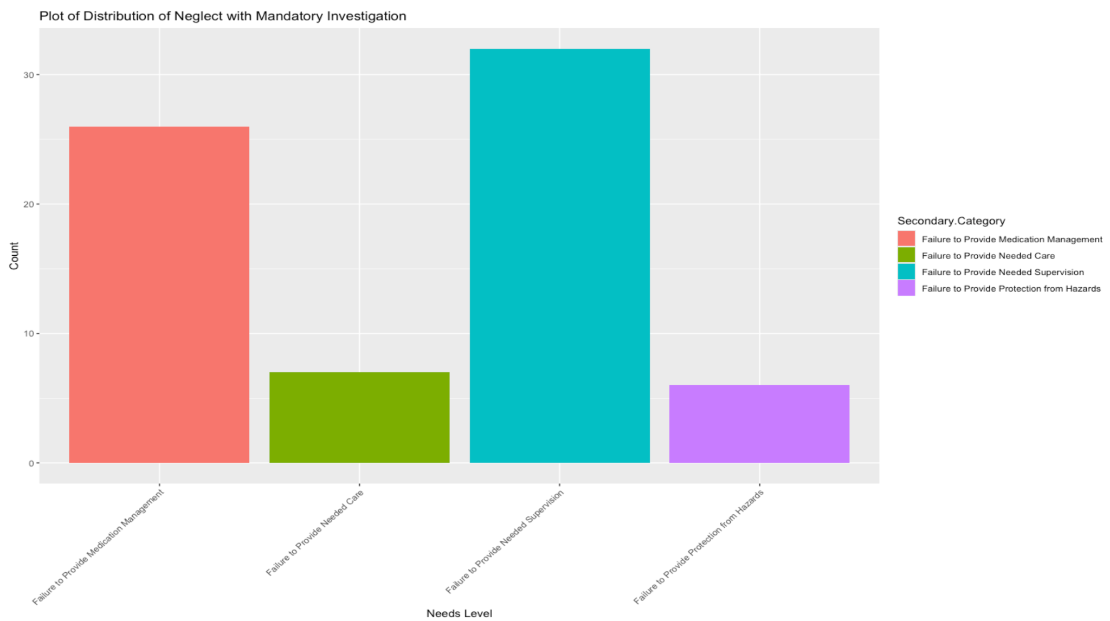
Neglect & Mandatory Investigation
Neglect is also the primary category with the most mandatory investigation, with most of them being failure to provide medical management and failure to provide needed supervision. Hence, these two categories might be something we want to focus on and try to avoid.
Notes:
Correct plot

Slide 19
Abuse

Slide 20
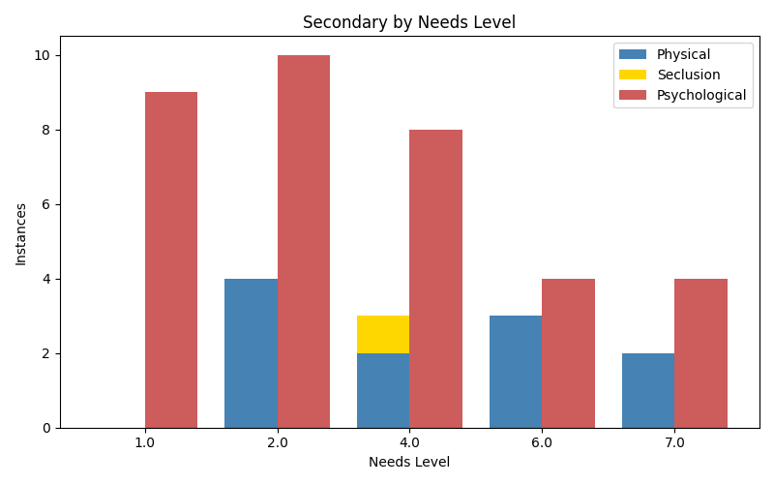
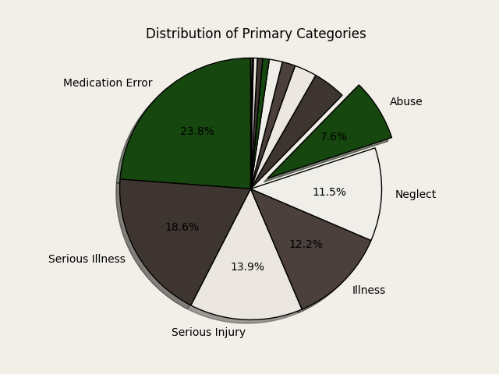
Basic Abuse Numbers
Secondary Category :
Psychological 35
Physical 11
Seclusion 1
No strong evidence that abuse differs by need level, but limited power to that statement, as we don’t have tons of data

Slide 21
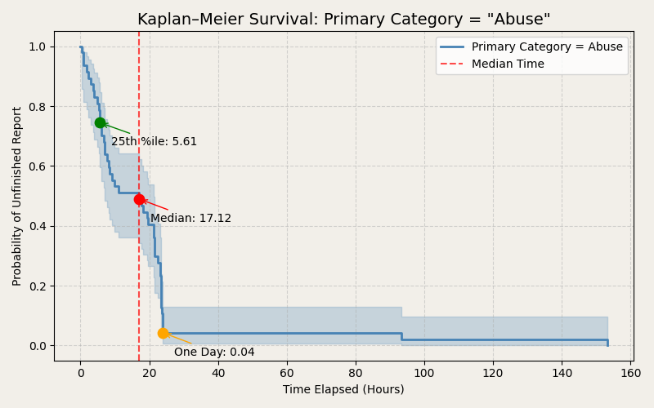
Abuse Reports over Time
No strong evidence that reporting time differs by type of Abuse.
This also holds for year, as we cannot say there is a trend in reporting time by year.
These conclusions are greatly influenced by the very limited amount of cases over the 3-year period.
Elapsed time, between occurrence and report, of abuse, only of incidents of abuse that were reported
Notes:
Not enough data to support any trend of abuse reporting time over year

Slide 22
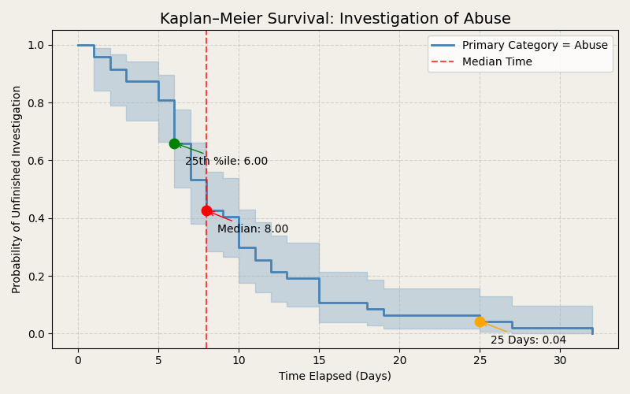
Abuse Investigations over Time
No strong evidence that investigation time differs by type of Abuse.
This also holds for year, as we cannot say there is a trend in investigation time by year.
These conclusions are greatly influenced by the very limited amount of cases over the 3-year period.
Elapsed time, between start and end of investigation, of abuse, only of incidents of abuse that were reported
Notes:
Not enough data to support any trend of abuse investigation time over year

Slide 23
Overview of Less Common Incidents
Rights Violation (5 cases) :
Service & privacy issues, mid-range needs levels (2-4), investigations took 2-15 days.
Law Enforcement Activity (4 cases):
All cases involve one person (Needs Level 7), handled externally.
Site Closure (3 cases):
Mostly loss of utilities, no follow-up investigations.
Fire (1 case):
Single occurrence, no recorded follow-up.
Fisher's exact test:
When having a Need Level of 7, it is more likely (5 : 79) to fell into one of the categories above than when it has a Need Level lower than 7 (9 : 524).
Notes:
Rights Violations (5 cases): These cases primarily involved denial of services and privacy issues. The affected individuals were mostly at mid-range needs levels (2-4), with investigations taking between 2 to 15 days. The data does not show any clear trends regarding when or why they occur.
Law Enforcement Activity (4 cases): A unique pattern emerged here—all cases were for the same individual (Erajah Sudduth-Jones, Needs Level 7). This raises questions about whether high-needs individuals receive adequate intervention before law enforcement is involved. Additionally, there were no internal investigations recorded, suggesting these cases were entirely handled by external authorities.
Site Closure (3 cases): These incidents were all related to loss of utilities, with no recorded investigation or response efforts in the dataset. This lack of follow-up could indicate a reporting gap or a lower prioritization of these cases.
Sexual Abuse (1 case): This was a single case categorized as rape. The affected individual had a Needs Level of 7 (the highest in our dataset), which might indicate vulnerability. Unlike other cases, this investigation was completed in just one day, possibly due to the severity of the situation.
Fire (1 case): This was an isolated incident with no recorded follow-up in the dataset, making it difficult to assess its impact or the response taken.

Slide 24
Thanks!

